Slide 1
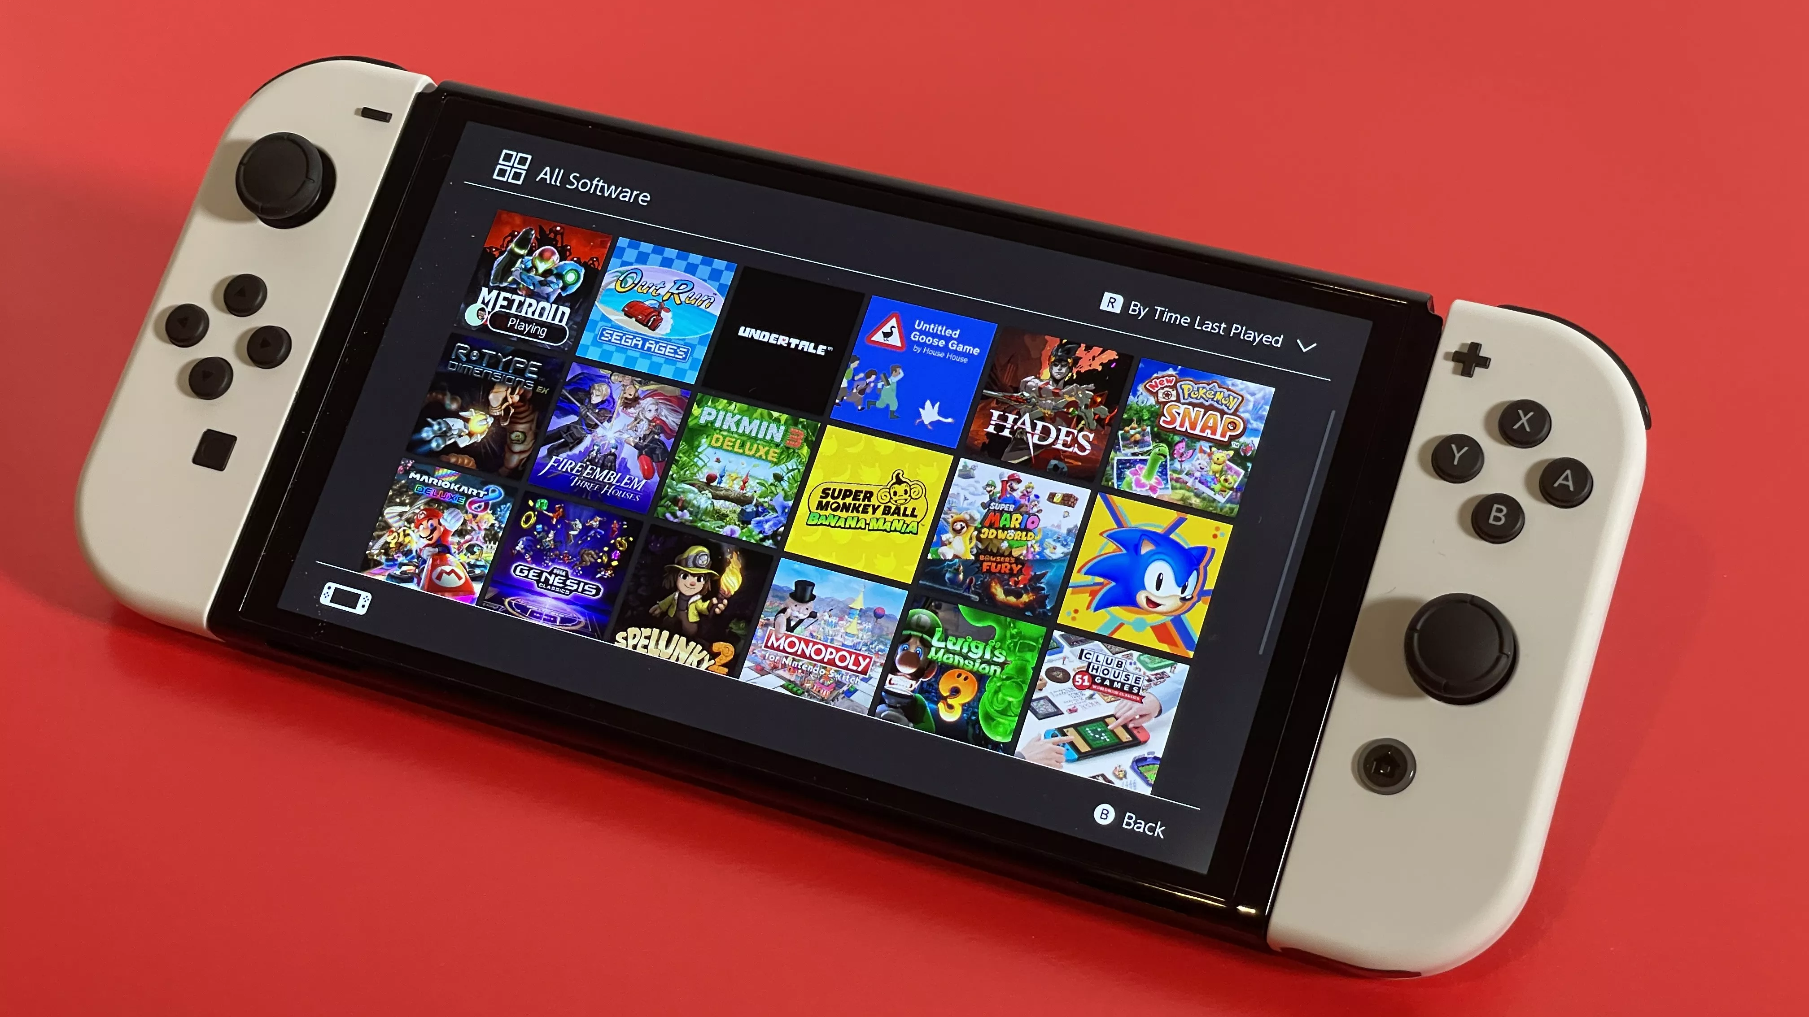
Nintendo Switch Game
Munira Hasasn & Martin Liu

Slide 2
introduction
Why have we picked Nintendo switch game?
1
This project will explore all the types of game in Nintendo switch database
2

Slide 3
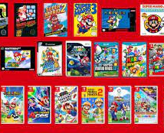
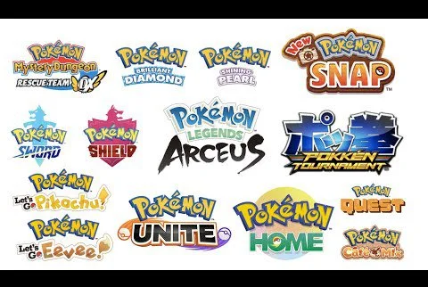
Designing
The attributes we used to create the database is table construct, insert, into, from, foreign key, primary key, not null and string operation.
Table Construct/ Entities : customer, games, sale_customer, sales_vendor and vendor
Customer: customer_name, date birth, emails, customer_ID
Games: game_id, title, year_rel, price, review, rating
and this are some examples
Games we used were Mario, Pokémon, The Legend of Zelda, Kirby Star Allies

Slide 4
Contribution
We split everything in half:
For milestone I, we divided the work in half. There were 5 questions and we split that by Martin got 3 question and I got 2 question.
For milestone II, we divided the work in half also. We constructed 5 entities. We split that in 3 – 2. Martin got customer, game, sales_customer and Munira got sales_vendor and vendor.

Slide 5
Problem
Sensitive cases
Examples : cutomer_id doesn’t match
Sql syntax errir not adding “”
Error Code: 1062. Duplicate entry '10004' for key 'sales_vendor.PRIMARY'

Slide 6
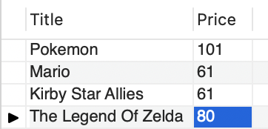
Use case
List of Names of Games and their prices
Select Title, Price from Game

Slide 7
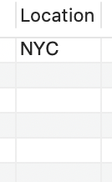
Use case
2) List the location that has sales for Pokemon
Select Location from Vendor,Sales_Vendor where Vendor.vendorId = Sales_Vendor.VendorId and Sales_Vendor.GameID = '2001';

Slide 8
Use case 3
List all Customers whose order quantity was greater than 1
select Name, Quantity
from Customer, Sales_Customer
where Customer.CustomerId = sales_customer.customerId and sales_customer.quantity > 1;

Slide 9

Show the database

Slide 10
Conclusion
We learned how to create a database from scratch
Jobs
Kahoot!

